Slide 1

Phishing Detection System using State-of-the-Art ML AND AI
Submitted by, Nikhil A Mathew

Slide 2
TABLE OF CONTENTS
01
02
03
04
05
INTRODUCTION
EXISTING SYSTEM
PROPOSED SYSTEM
IMPLEMENTATION
CONCLUSION

Slide 3

INTRODUCTION
This project introduces a Phishing Detection System utilizing advanced ML and AI techniques.
It involves the implementation of tailored deep learning models for websites and URLs, integrating NLP, behavioral analysis, and anomaly detection.
Mainly aims for increased detection accuracy, adaptability to emerging threats, and a refined user experience.

Slide 4
EXISTING SYSTEM
Static Rule-Based Approach
Limited ML Integration
Static rules and signature-based methods for phishing detection.
Basic ML for feature extraction but lack advanced techniques.
Less Emphasis on User Experience
Absence of Client-Side Security Measures
Lack of real-time notifications and interactive features for users.
Server-side detection without incorporating client-side security measures.

Slide 5
PROPOSED SYSTEM
Advanced ML and AI Techniques
Client-Side Security Measures
Static Analysis and Behavioral Detection
Implement NLP, behavioral analysis, anomaly detection, and ensemble learning for improved accuracy
Integrate client-side security measures through a browser extension, providing real-time alerts and page analysis
Conducted static analysis to identify common vulnerabilities such as buffer overflows and SQL injection flaws

Slide 6
TWO MODULES
USER
ADMIN
The extension fetches the current tab URL and sends it to API and predicts the result
Can input the URL/IP to get the detailed results.
Can report the phishing or suspicious URLs.
Can manage URL/IP report details.
Can respond to feedbacks and queries of users.

Slide 7
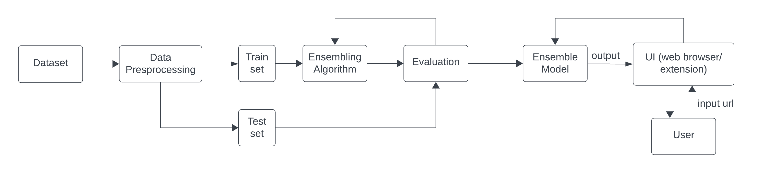
PROCESS FLOW

Slide 8
IMPLEMENTATION
This project implements BERT (Bidirectional Encoder Representations from Transformers) framework for extracting the features from URL and predict using ensemble model to get the result.

Slide 9
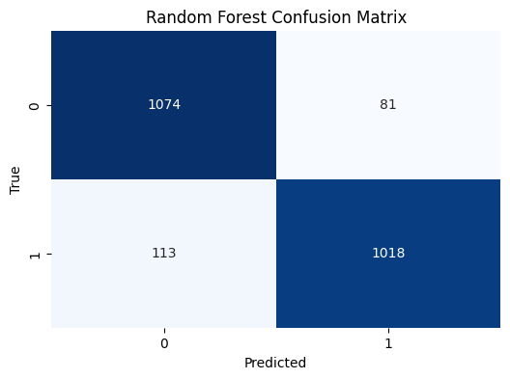
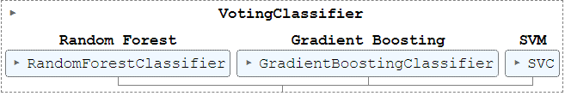
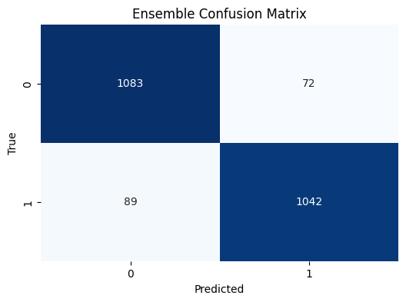

SVM
Random Forest

Slide 10
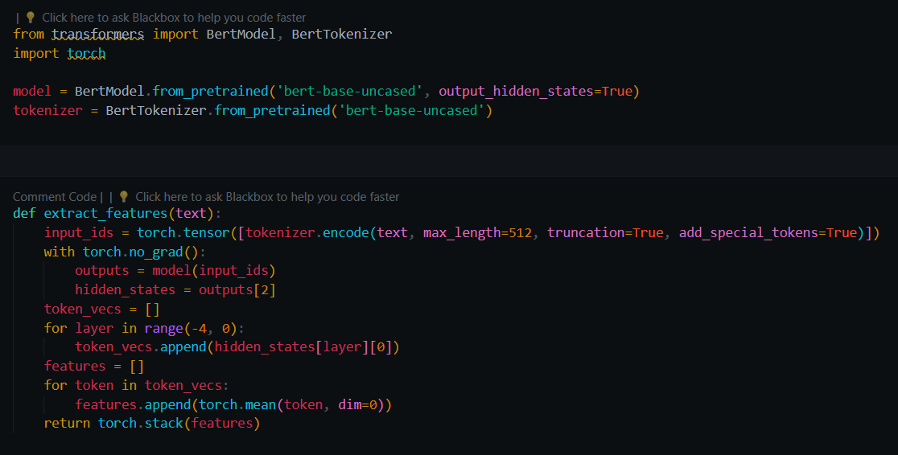
FEATURE EXTRACTION

Slide 11
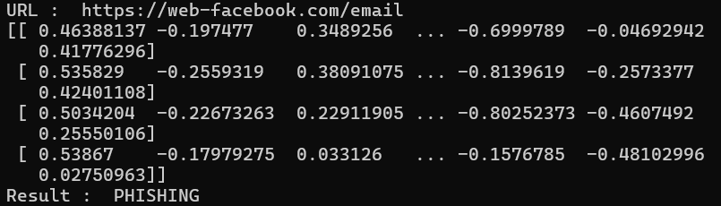
TEST CASE 1

Slide 12
SYSTEM REQUIREMENTS
01 | Front-End | Framework: Vanilla JavaScript Languages: HTML5, CSS, JavaScript
02 | Back-End | Framework: Flask Languages: Python Database: MongoDB
03 | Libraries | Flask, Numpy, PyMongo, LabelEncoder, SMOTE, BertModel, BertTokenizer

Slide 13

SCREENSHOTS
Feature 1: Real-Time Detection

Slide 14
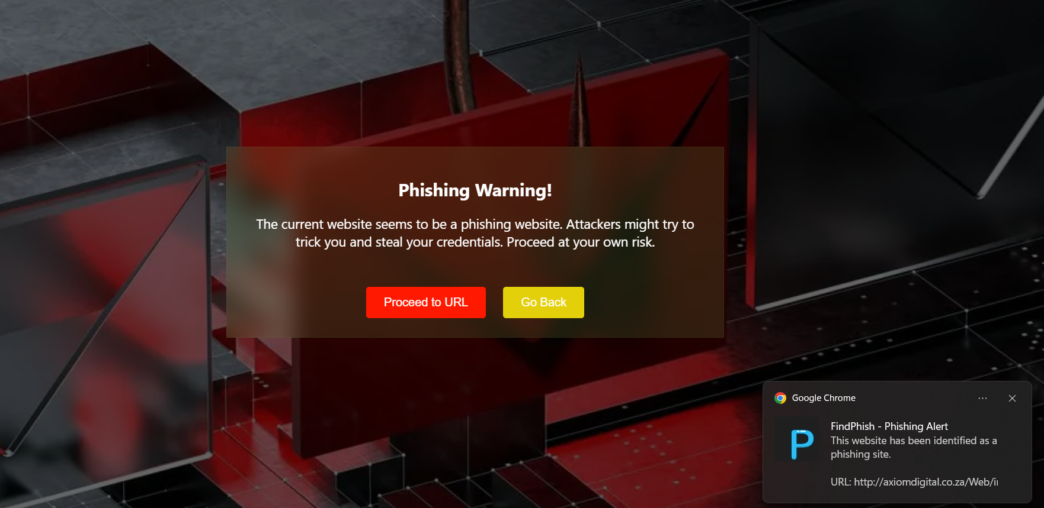
SCREENSHOTS
Feature 2: Real-Time Notifications

Slide 15
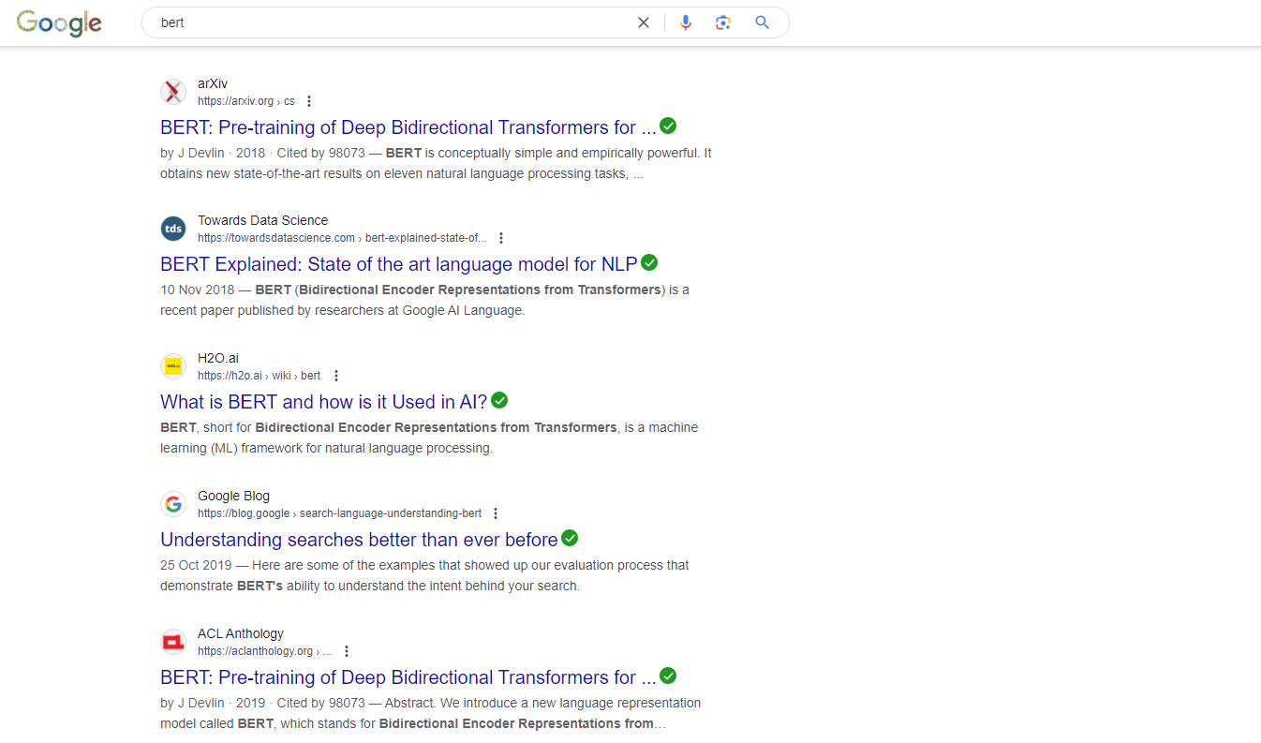
SCREENSHOTS
Feature 3: Search Advisor

Slide 16
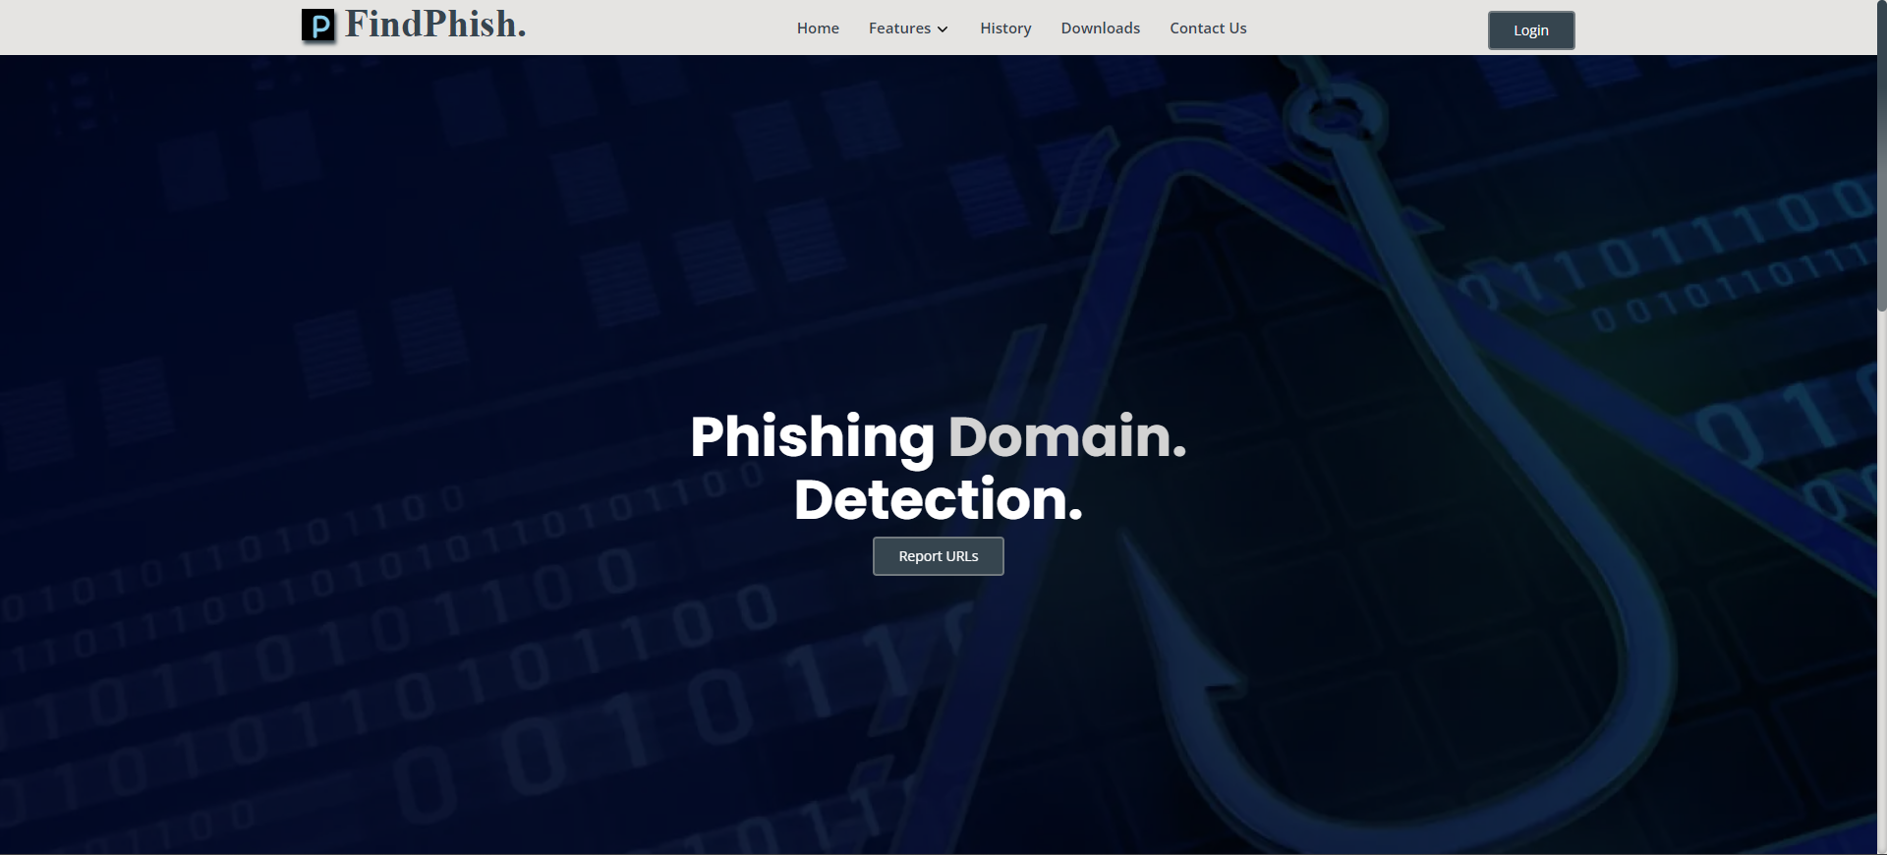
SCREENSHOTS

Slide 17
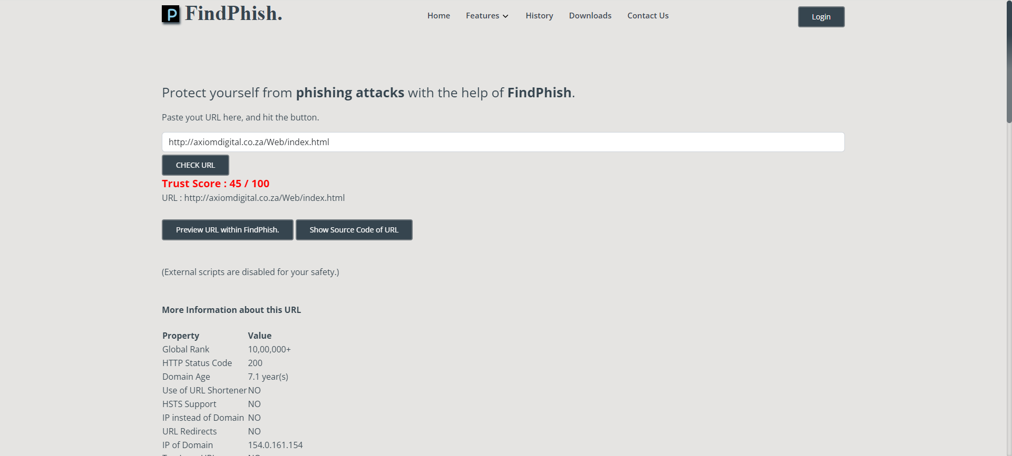
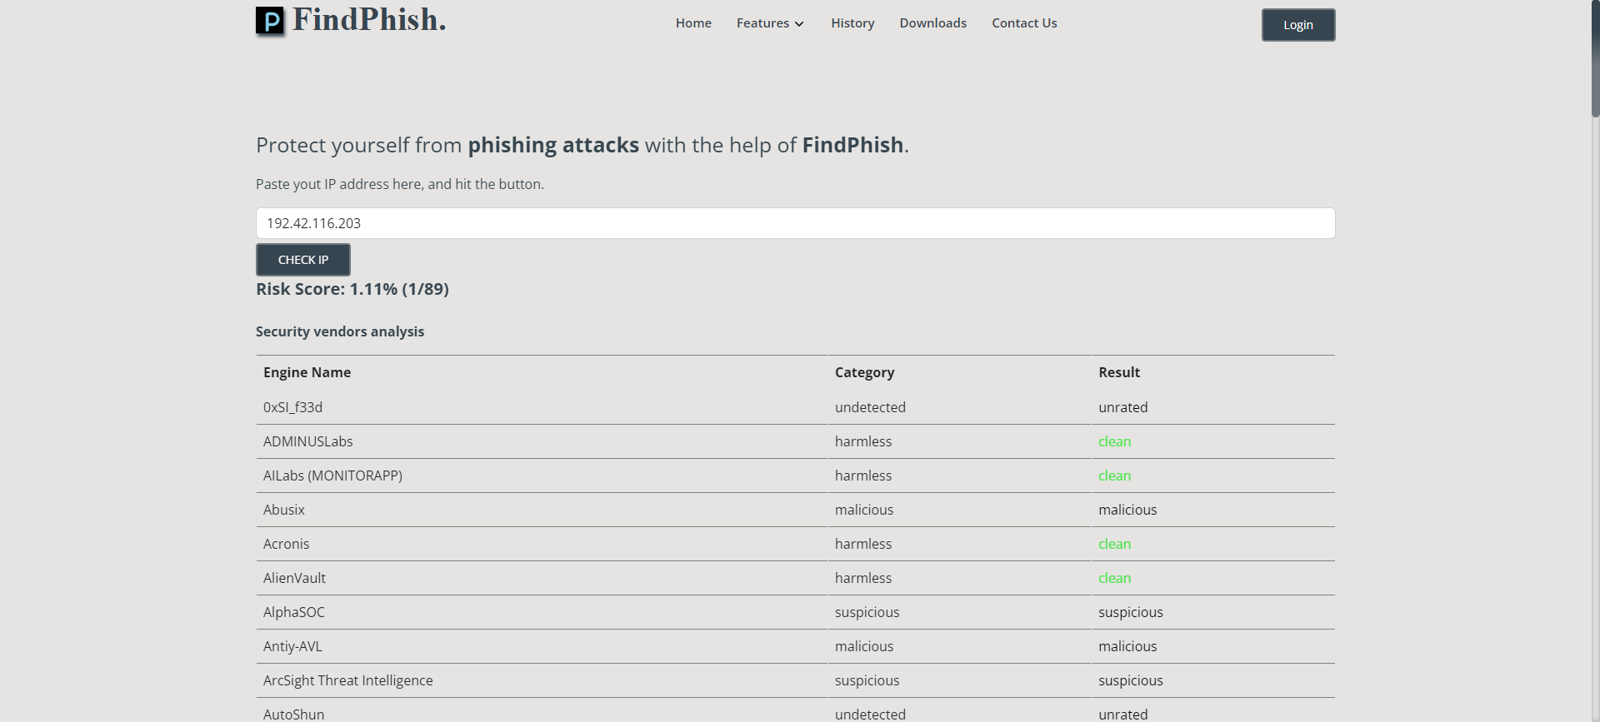
SCREENSHOTS
Feature 4: Check URL & IP

Slide 18
CONCLUSION
This project aims to revolutionize phishing detection by seamlessly integrating advanced ML and AI techniques, providing a proactive and user-centric defense against evolving cyber threats.
User experience is a central focus, with a user-friendly web application dashboard, real-time alerts, and educational resources to empower users in recognizing and reporting potential threats.

Slide 19
REFERENCES
“A systematic literature review on phishing website detection techniques”, Asadullah Safi, 2023.
“BERT Against Social Engineering Attack: Phishing Text Detection”, Nafiz Rifat, 2022.
“https://www.kaggle.com/code/sujithmandala/phishing-domain-detection-bert-log-reg-96-ac

Slide 20

THANK YOU

